Slide 1







SpaceX Rocket Data Analysis
Vignes KV
August 4, 2024

Slide 2



OUTLINE
Executive Summary
Introduction
Methodology
Results
Visualization – Charts
Dashboard
Discussion
Findings & Implications
Conclusion
Appendix

Slide 3

EXECUTIVE SUMMARY
SpaceX is the most established private satellite company in the world
As SpaceY, our goal is to out-compete them by first understanding their methodologies of space launches throughout various rocket launch locations
There are several reasons SpaceX is very successful as a rocket company
Multiple stages to launch rocket (first stage is to send rocket to space and land rocket successfully, and second stage helps bring payload to orbit)
They reuse part of the rocket launch to save dramatically on costs
Other companies spend ~$180 million per rocket launch, but SpaceX only spends about $60 million per rocket launch
By predicting whether the first stage of the rocket will land, given certain factors such as rocket type, payload weight, and orbit, we can effectively determine whether SpaceX satellites will be successful, and use those factors to our advantage at SpaceY.

Slide 4

INTRODUCTION
Satellites have been launched by rockets since the Soviet Union launched Sputnik in 1969
Most of the work has diverged from the public sector (such as USA’s NASA, and other nation’s governments) into the private sector as they can better prioritize profitability and other private interests
Several companies have started working on satellite launches, such as Globalstar, Jeff Bezo’s Blue Origin, Sir Richard Branson’s Virgin Galactic, but probably the most well-known and successful of them all is Elon Musk’s SpaceX, which was last valued at ~$200 billion.
SpaceX’s success has come from their multi-stage launches, which enable them to reuse rockets after launching them so that they can continue using the same parts for multiple launches after they have deployed the satellites into space.
By understanding and determining whether satellite launches are successful based upon multiple factors such as payload amount, rocket type, and other factors, we can effectively determine whether the rocket can be successfully landed and reused in future missions.

Slide 5

METHODOLOGY
We first source data from SpaceX’s public REST API: https://github.com/r-spacex/SpaceX-API
On this dataset, we will perform Exploratory Data Analysis (EDA) to understand the overall structure of the dataset as well as general statistics
We will then perform data scraping from Wikipedia’s historical table of Falcon 9 launches: https://en.wikipedia.org/wiki/List_of_Falcon_9_and_Falcon_Heavy_launches
Using Beautiful Soup, we will again perform EDA to understand the structure and statistics of this dataset
We will also utilize SQL and Folium with EDA to visually determine certain aspects of each rocket launch
We will create an interactive visual dashboard using Plotly and Dash to determine the success rate of each rocket launch given the payload and rocket type, as well as other statistics
Finally, we will utilize several machine learning models (such as Decision Trees, kNNs, and SVMs) to determine whether we can predict successful rocket launches given the above dataset

Slide 6
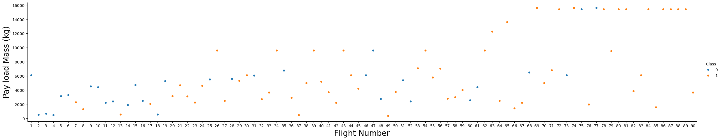
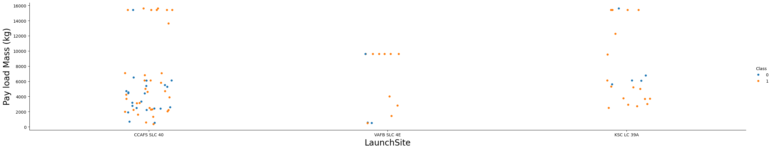
SPACEX EDA RESULTS
From the figure above, we can see that the majority of flights are successful, particularly those that happened more recently and with higher payloads.
Comparing the launch sites, we can see that RSC LC 39A and VAFB SLC 4E are the more successful launch sites.

Slide 7
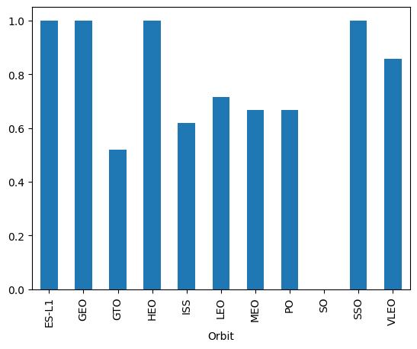
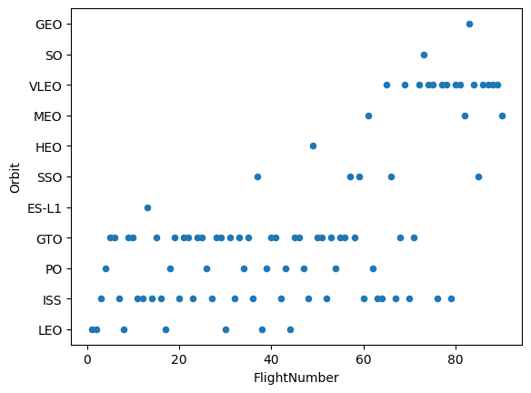
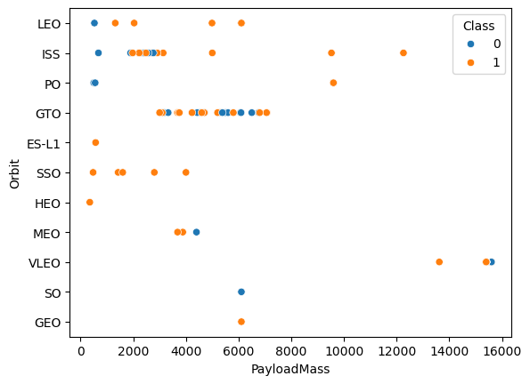
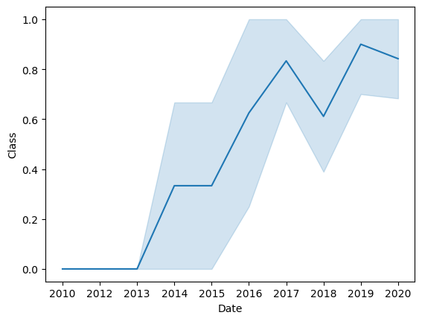
SPACEX EDA RESULTS
Top Left: This figure compares the different forms of orbit with the success rate of each mission. From the image, we can see that ES-L1, GEO, HEO, and SSO orbit patterns have the highest success rate of 100%.
Top Right: This image depicts the chronological order of each flight and the type of orbit that it wants to achieve. As you can see, the focus seems to be shifting from GTO and ISS, towards orbits like VLEO.
Bottom Left: This graph compares the payload mass of each rocket with the anticipated orbit, as well as the success of each mission. As we can see, most missions are generally successfully, with generally lower payload missions being unsuccessful.
Bottom right: This graph depicts the success rate of all mission in all given years. As we can see from the trendline, SpaceX has had more successful missions over the years.

Slide 8
SPACEX SQL RESULTS
From the SQL EDA, the following results have been determined:
There are four launch sites that SpaceX has launched from: CCAFS LC-40, KSC LC-39A, KSC LC-39A.
The total payload mass carried by boosters launched by NASA was 45596 kg.
Average payload mass carried by the F9 v1.1 booster was about 2534.67 kg.
The earliest successful landing on a ground pad was on June 4, 2010.
There were four boosters that have had success in drone ship landings and carried payloads between 4 and 6 thousand kilograms:
-F9 FT B1022
F9 FT B1026
F9 FT B1021.2
F9 FT B1031.2
There were 100 successful mission outcomes and only 1 failure mission outcomes.

Slide 9
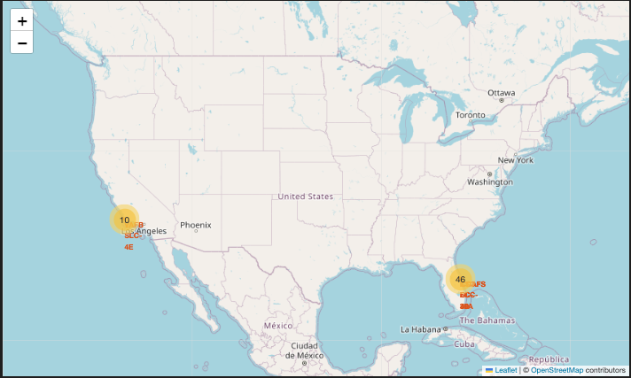
SPACEX FOLIUM RESULTS
After plotting all of the SpaceX locations on Folium, the results look like the image to your left.

Slide 10
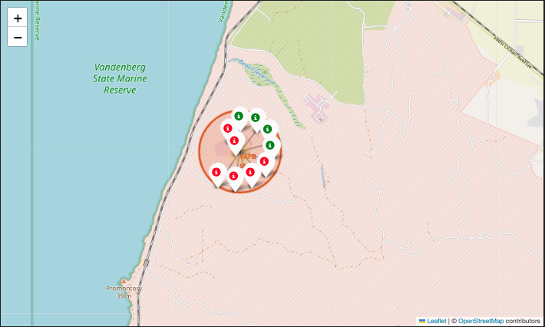
SPACEX FOLIUM RESULTS
Clicking on the VAFB SLC-4E region for example allows us to see the number of successful (represented by green) and unsuccessful (represented by red) markers.

Slide 11
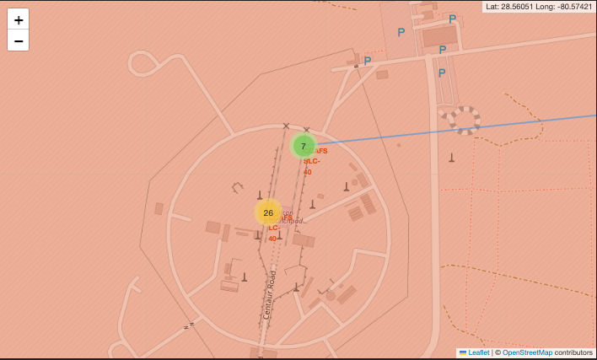
SPACEX FOLIUM RESULTS
Similar example with the two launch locations in Florida as well. Unfortunately, I was not able to get the PolyLine functionality working with my system, as you can see with the stray blue line on the map. However, I can make these initial impressions:
- Launch locations seem to be within a mile of a highway, and about two miles from a railroad. However, they seem to be pretty far from cities, which makes sense for safety reasons.

Slide 12
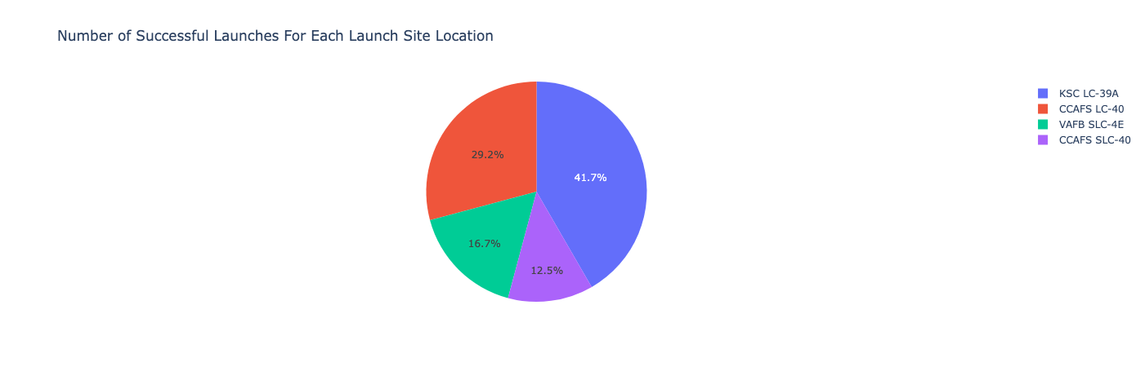
SPACEX DASH RESULTS
From this pie chart, we can clearly see that the KSC LC-39A location has the most successful launches out of all locations, followed by the VAFB SLC-4E location.
After generating pie charts for each location, we can see that the KSC LC-39A has the highest landing success rate out of all sites at 76.9%, followed closely by CCAFS LC-40 at 73.1% success rate, VAFB SLC-4E at 60%, and CCAFS SLC-40 at 57.1%.

Slide 13
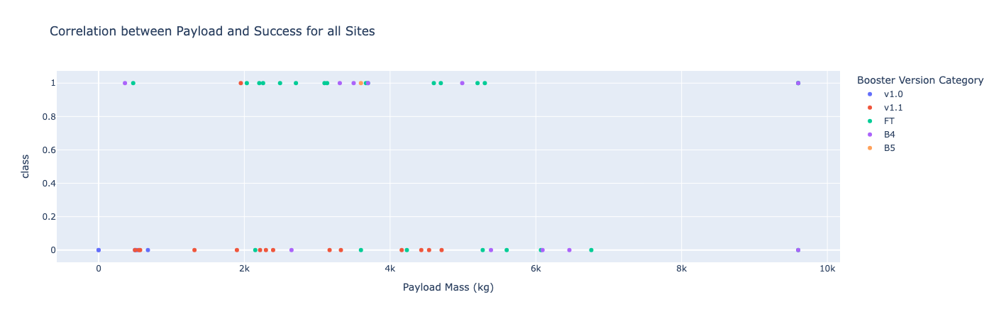
SPACEX DASH RESULTS
From this graph, we can compare the success of each rocket launch with the booster version category and its payload mass. As we can see generally FT missions are successful, and v1.1 missions are failures. With the help of Plotly and Dash, we can adjust the payload range and specific launch sites as well (next slide).

Slide 14
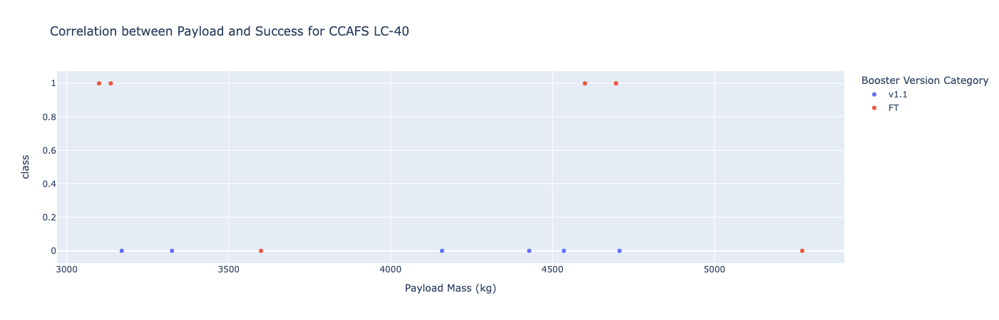
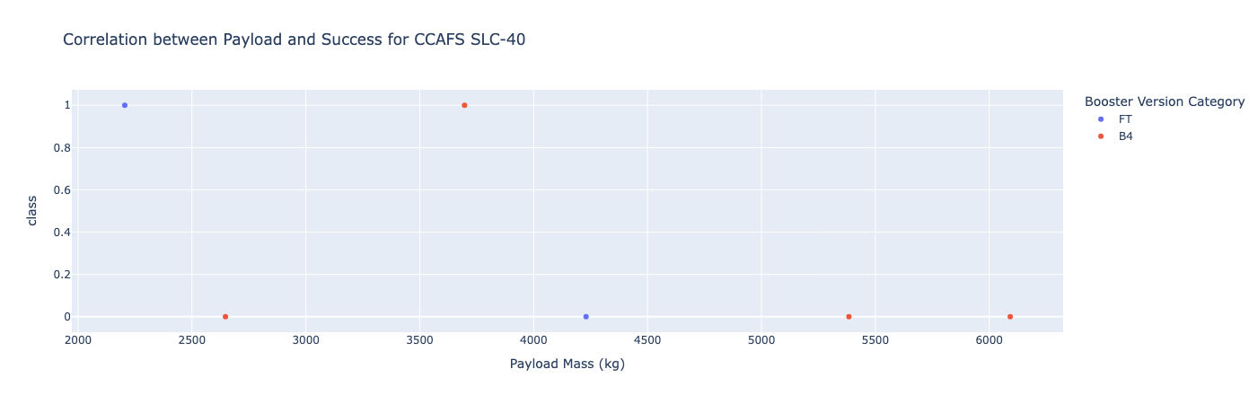
SPACEX DASH RESULTS

Slide 15
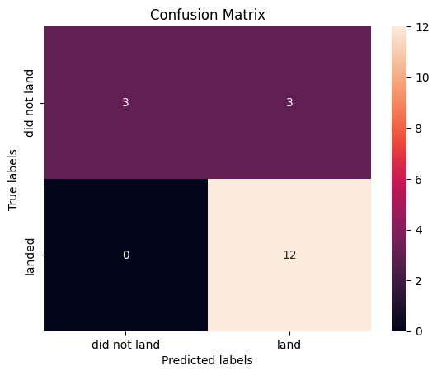
SPACEX PREDICTIVE ANALYSIS RESULTS
After analyzing this data, we have considered implemented several machine learning models to figure out which one is best at predicting successful landings given the payload mass, flights, orbit, number of grid fins, and other such attributes. The models that we have considered training along with their accuracies are the following:
Logistic Regression (training: 0.846, testing: 0.833)
SVM (training: 0.848, training: 0.833)
Decision Trees (training: 0.877, testing: 0.833)
K-nearest neighbors (training: 0.848, testing: 0.833)
Since all models performed the same on the testing data, the confusion matrices of all models can be found to the LHS. However,

Slide 16

CONCLUSION
SpaceX is a very successful rocket-launching company due to many factors, including:
Their one-of-a-kind rocket reusability launching technique, which saves dramatically on costs
An overall 67% successful rate and a success rate that is over 80% in the year 2020 with a positive trendline
Their unique locations near the Atlantic and Pacific coastlines that are also near NASA government facilities
Many space launches are going from a GTO or VSS orbit to ones like VLEO due to a higher success rate.
The most successful launch site is also the same place with the most successful launching percentage, that being the KSC LC-39A launch site.
In terms of predictive analysis, an SVM model seems to predict successful launches the best with an overall training accuracy of 88% and testing accuracy of 83%.
In order for SpaceY to beat SpaceX, we suggest utilizing the many techniques that SpaceX currently uses that enabled them to be the world’s most renowed rocket launching company, but even better.

Slide 17
REFERENCES
GitHub repository: https://github.com/vignes-12/spacex-rocket-analysis
SpaceX Open-source REST API: https://github.com/r-spacex/SpaceX-API
Wikipedia List of Falcon 9 and Falcon Heavy Launches: https://en.wikipedia.org/wiki/List_of_Falcon_9_and_Falcon_Heavy_launches

Slide 18
THANK YOU!

